Slide 1
Spring + Databases
Start MySQL & Run Spring Server !!!
Dr Simon Lock
simon.lock@bristol.ac.uk

Slide 2
Overview
Aim of this sessions is to look at DBs within Spring
Most projects are going to require some kind of DB
We are going to focus on relational DBs (MySQL)
However the concepts should transfer to other DBs

Slide 3
Knowledge
You should have covered DB basics previously (?)
We’ll now build on that knowledge with Spring
What you will see today are MINIMAL examples
Just enough to get something up and running
You’ll probably want to extend & improve them !

Slide 4
Word of warning
Remember how you spent all that time on SQL ?
Learning about tables, columns, keys and entries ?
All of those query language keywords:
SELECT UPDATE DELETE DROP JOIN
Remember it was “fundamental knowledge” ?
That was mostly true ;o)
A

Slide 5
General approach
Spring aims to reduce programming effort
Removing the need to write SQL
(although it is still possible for custom queries !)
Instead you provide some hints using annotations
And Spring does all the low-level querying for you !

Slide 6
Project Database
Lets build a simple Project database
To hold (very) basic information about SPE Projects:
This database has already been created in MySQL
We won’t be looking at this kind of DB admin here
id
name
1
Final grade calculator
Projects Table
2
Food miles app
3
Tinder for cats

Slide 7
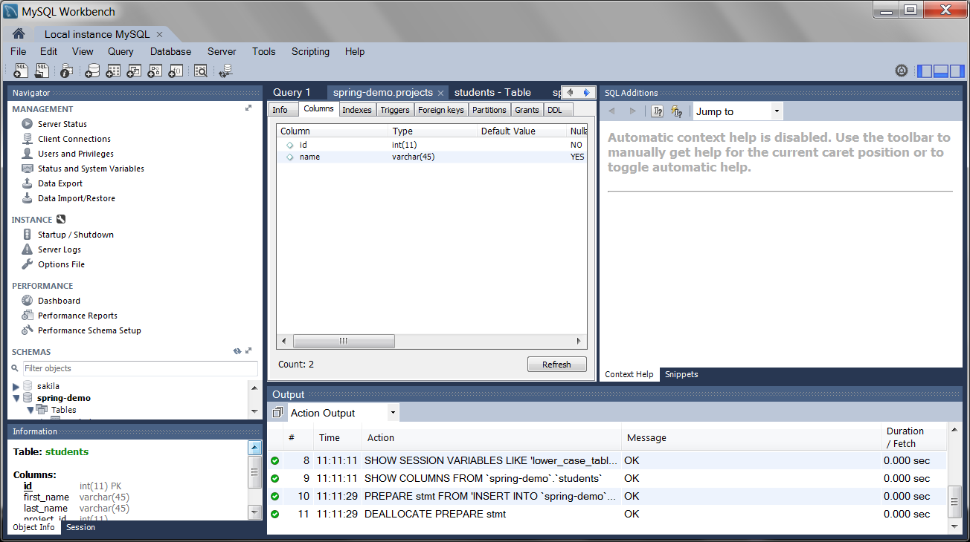
MySQL Workbench

Slide 8
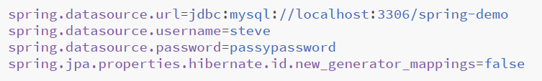
Database credentials in properties file
Why in a properties file ?
Well, you probably don’t want this made public
On a GIT repository for example !
A

Slide 9
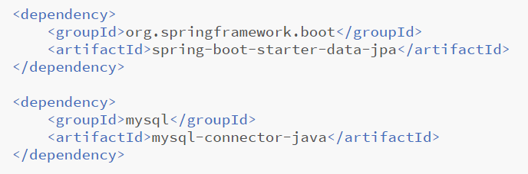
Adding dependencies to your POM
Initializr will do it for you !
https://start.spring.io
A

Slide 10
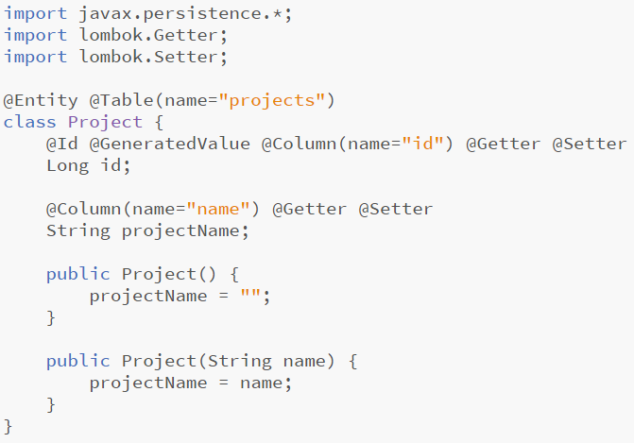
The Project Class
id
name
1
Final grade calculator
“projects” Table
2
Food miles app
3
Tinder for cats

Slide 11
Database annotations
id
name
1
Final grade calculator
“projects” Table
2
Food miles app
3
Tinder for cats
A

Slide 12
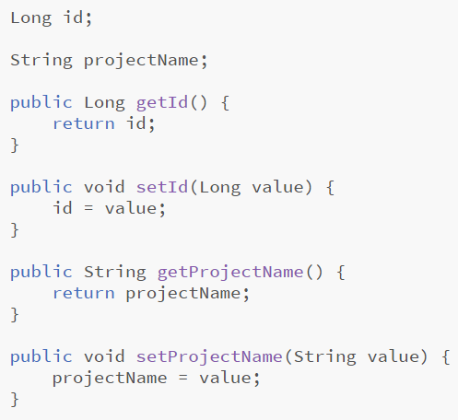
Write some getters and setters ?

Slide 13
No need with Spring !!!
A

Slide 14
CrudRepository
Spring provides the CrudRepository interface
Reminder: CRUD is Create Read Update Delete
The CrudRepository handles all access to the DB
It provides us with various useful methods…
Checking: count, existsById
Searching: findById, findAll
Creating and updating: save, saveAll
Removal: delete, deleteById, deleteAll

Slide 15
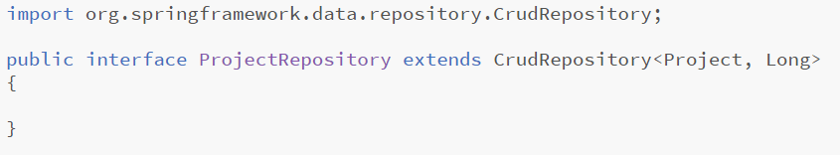
Using the CrudRepository
To use the CrudRepository, we need to extend it
This might seem a bit strange !
But it’s part of the magic of Spring !!!
Extending allows us to specify types to operate on
Also have option of adding custom methods later

Slide 16
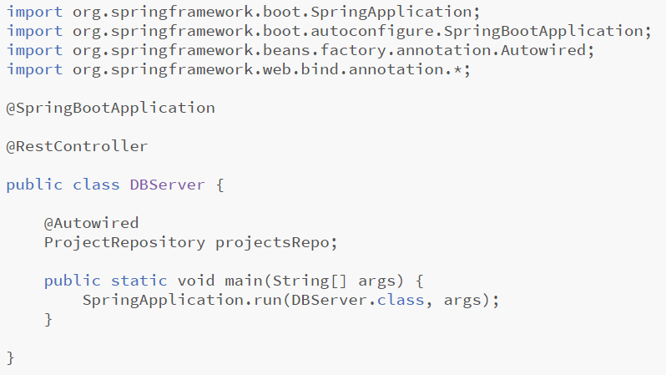
Main class code skeleton

Slide 17
Instantiate the CrudRepository ?
A

Slide 18
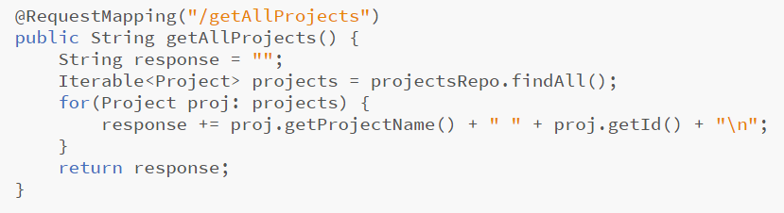
Getting all projects
http://127.0.0.1:8080/getAllProjects?

Slide 19
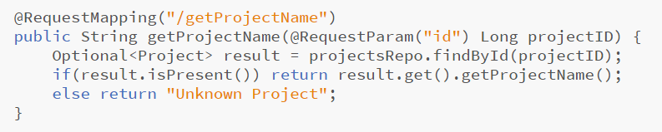
Getting a project by ID
http://127.0.0.1:8080/getProjectName?id=1

Slide 20
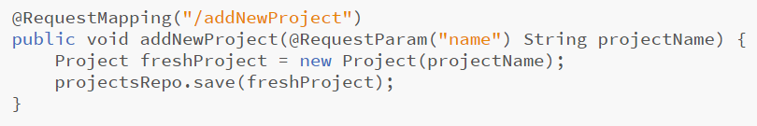
Adding a new project
!!! WARNING !!!
Powerpoint will
open this 3 times !
http://127.0.0.1:8080/addNewProject?name=Fish+App
http://127.0.0.1:8080/getAllProjects?
A

Slide 21
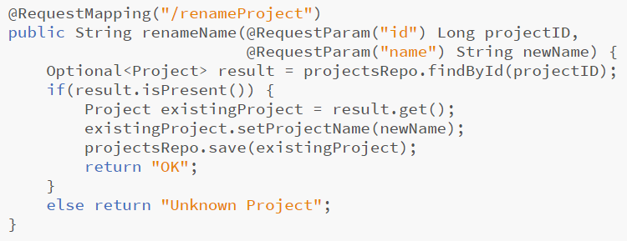
Updating an Existing Project
http://127.0.0.1:8080/renameProject?id=2&name=ipod

Slide 22
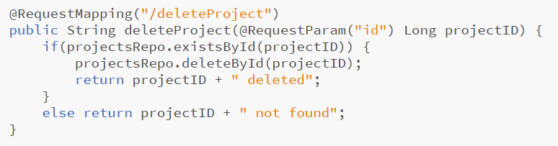
Deleting a project by ID
http://127.0.0.1:8080/deleteProject?id=5
http://127.0.0.1:8080/getAllProjects?

Slide 23
Relationships between Objects
Again, Spring tries to make things easy for us
We provide some hints in the form of annotations
Spring does all of the low-level ugly stuff
We first need to specify the cardinality/multiplicity:
OneToOne ManyToOne OneToMany ManyToMany
Then we need to indicate the keys used in the DB
JoinColumn
Let’s look at an example…

Slide 24
Students working on Projects
Each project is worked on by a team of students
We first need a table to store Student information
Each student has an ID, first name and last name:
Lets also store the ID of their allocated project
A

Slide 25
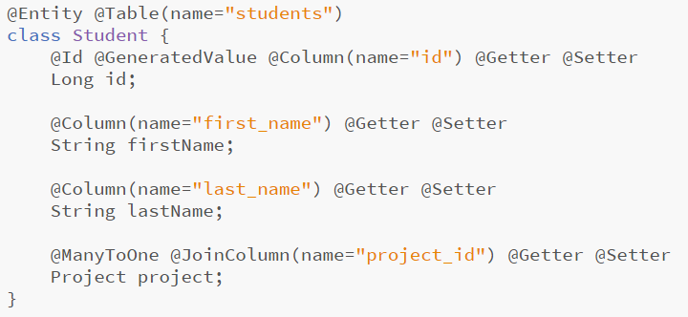
Object Relationship
A

Slide 26
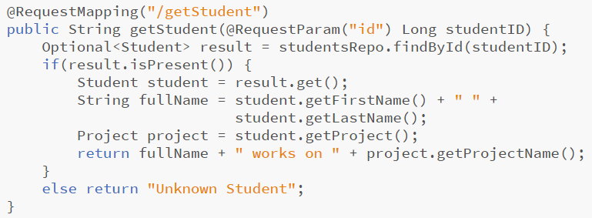
Querying Students
http://127.0.0.1:8080/getStudent?id=2

Slide 27

Inverse Relationship (Advanced !)
We can ask Spring to create inverse relationships
I.E. The Project object gets a link to all student members
This is again done by defining the cardinality:
OneToOne ManyToOne OneToMany ManyToMany
But rather than specifying the MySQL table column
We give it the variable name from the Student object
Spring links and populates the list automatically !!!

Slide 28
Other DBMS are available
Spring CRUD supports a wide variety of DBMS
A wide range of SQL and NoSQL databases:
LDAP, MongoDB, Redis, Cassandra, Solr,
Pivotal GemFire, MySQL, Postgres, DB2,
various other JDBC supported databases
All you need to do is add dependency to the pom
Probably ;o)
A

Slide 29
More Information
This has just been a (relatively) gentle introduction
Just something to get you started
There is much, much more to Spring Data
Further details can be found on the reference site:
https://docs.spring.io/spring-data/commons/docs/current/reference/html/

